Slide 1
How to present your results
January 2024
Animal physiology Lab

Slide 2
Overview
15 minutes presentation + 5 minutes for questions.
Article-like structure (not including the abstract).
Everyone has to talk (try to give equal parts to all).
Keep it precise - don’t write a lot of text, but elaborate verbally.
Be as cute as you want - we’re not judging your seriousness (out loud...).
30% of your grade.

Slide 3
Grade Components
Participation
Clarity of presentation
Validity of conclusions
Appearance
Structure
Knowledge
Compatibility of methodology to research question
Controls and pilots
Presentation time

Slide 4


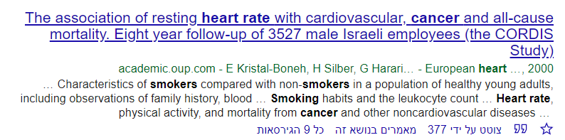

Title slide
Don’t forget to write your names.
Make it informative but interesting.

Slide 5
Introduction
Talk to a novice electrophysiologist (don’t tell me that the heart is a blood pump).
Keep it short and interesting - videos and graphs are more than welcome.
If your research is based on another researches results - show the relevant results.
The funnel method.
Finish with your hypothesis / research question.

Slide 6
Hypothesis
Nominal
Should be derived from the introduction.

Slide 7
Methods
Better show than write.
This is your moment to shine - don’t be stingy.
Give us the full picture.
Talking about your controls and pilots is important.

Slide 8
Results
Use standard units.
Tell us about your analysis.
Don’t interpret - just say what you’ve seen and analyzed.
A graph is better than a 1000 words.

Slide 9
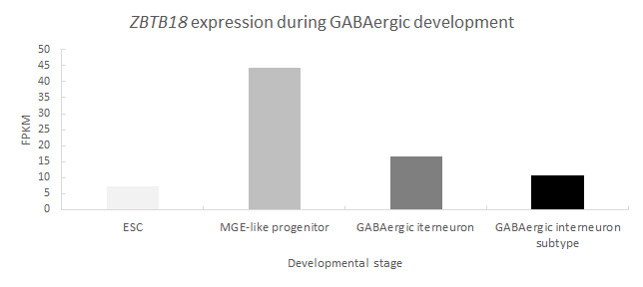
Results

Slide 10
Discussion
Interpretation
Research limits
Possible future researches

Slide 11


